Slide 1

Unit-1 Introduction to Indian Knowledge System
Indian Knowledge System
#2301DU005
Prof. Deepraj K. Patadia
Civil Engineering Department
deepraj.patadia@darshan.ac.in
7990475865

Slide 2
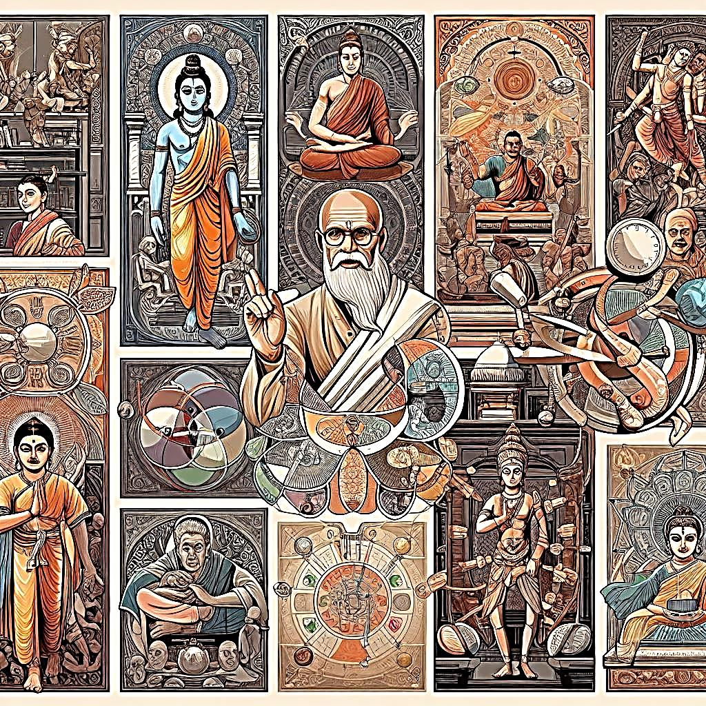

Looping
Introduction to Indian Knowledge System
Introduction to Indian Knowledge System
Base of Ancient Knowledge System
History and Definition of Indian Knowledge System
Framework of Indian Knowledge System & ‘Sutras’
Encryption (Ancient Methods of Encryption)

Slide 3

Introduction

Slide 4
Need of Indian Knowledge System

Slide 5
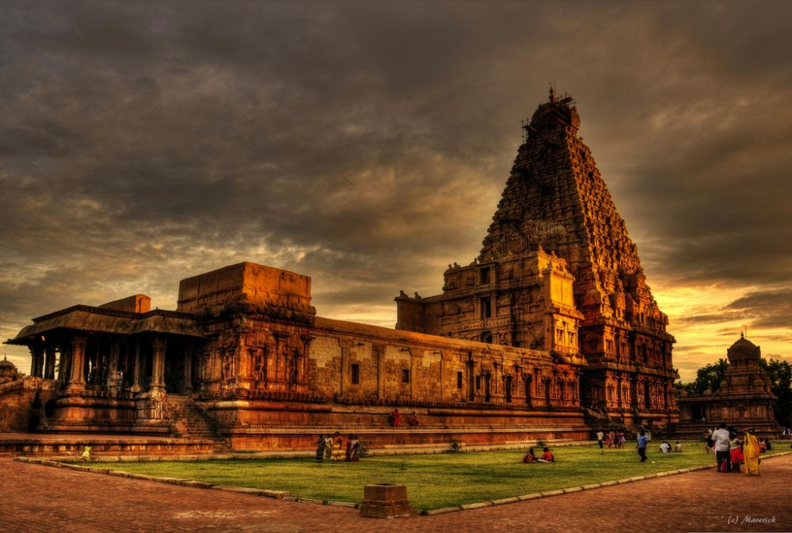
What do you recognize in this picture?
When it was built up?
How they designed it ?
Shape and Structure?
It was built by Raja Chola - I
Construction completed in 1010
60,000 tons of granite used
Tallest Vimanas (Temple tower)
Tallest Kumbham (Top structure) Approx. weight of 80 tons in top.
Brihadeeswara Temple
(Thanjavur, Tamilnadu)
This is just an ‘Architect Example’.
We do have lots of such stunning examples in our history unknown to us.
5

Slide 6
Introduction to Indian Knowledge System
Ancient Indian Knowledge:
Indian knowledge systems have been prominent and advanced since the earliest periods of human civilization, dating back at least 5000 to 8000 years.
Contrary Beliefs:
It is incorrect to assume that most benefits to human civilization solely originate from Western, Chinese, or Egyptian civilizations.
17th Century Steelmaking:
In the 17th century, India was notably recognized for its expertise in steelmaking.
Indian artisans produced renowned Damascus blades and Wootz steel.
The unique properties of Wootz steel were unparalleled and could not be replicated by other metallurgists of the time.

Slide 7

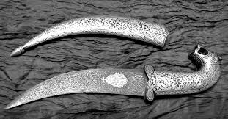
Introduction to Indian Knowledge System
Damascus Steel Blades
Wootz Steel Blade

Slide 8
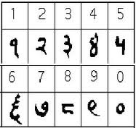
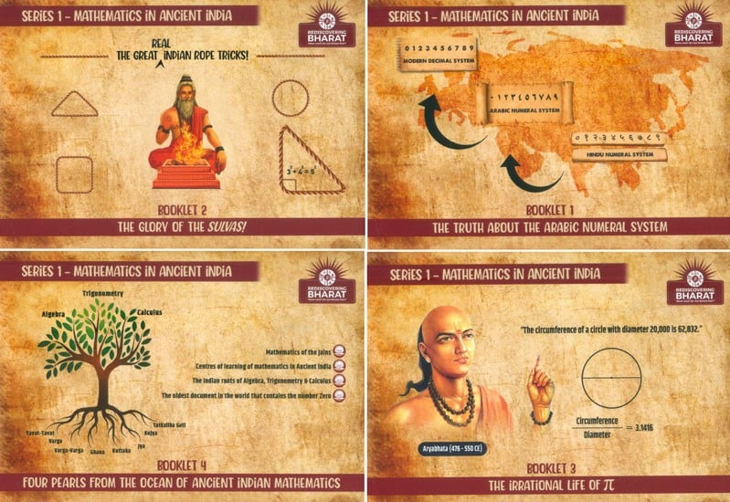
Introduction to Indian Knowledge System
India also contributed in the fields of Number Systems, Mathematics, Astronomy in first millennia (પ્રથમ સહસ્ત્રાબ્દી).
Number System Ancient Mathematics

Slide 9
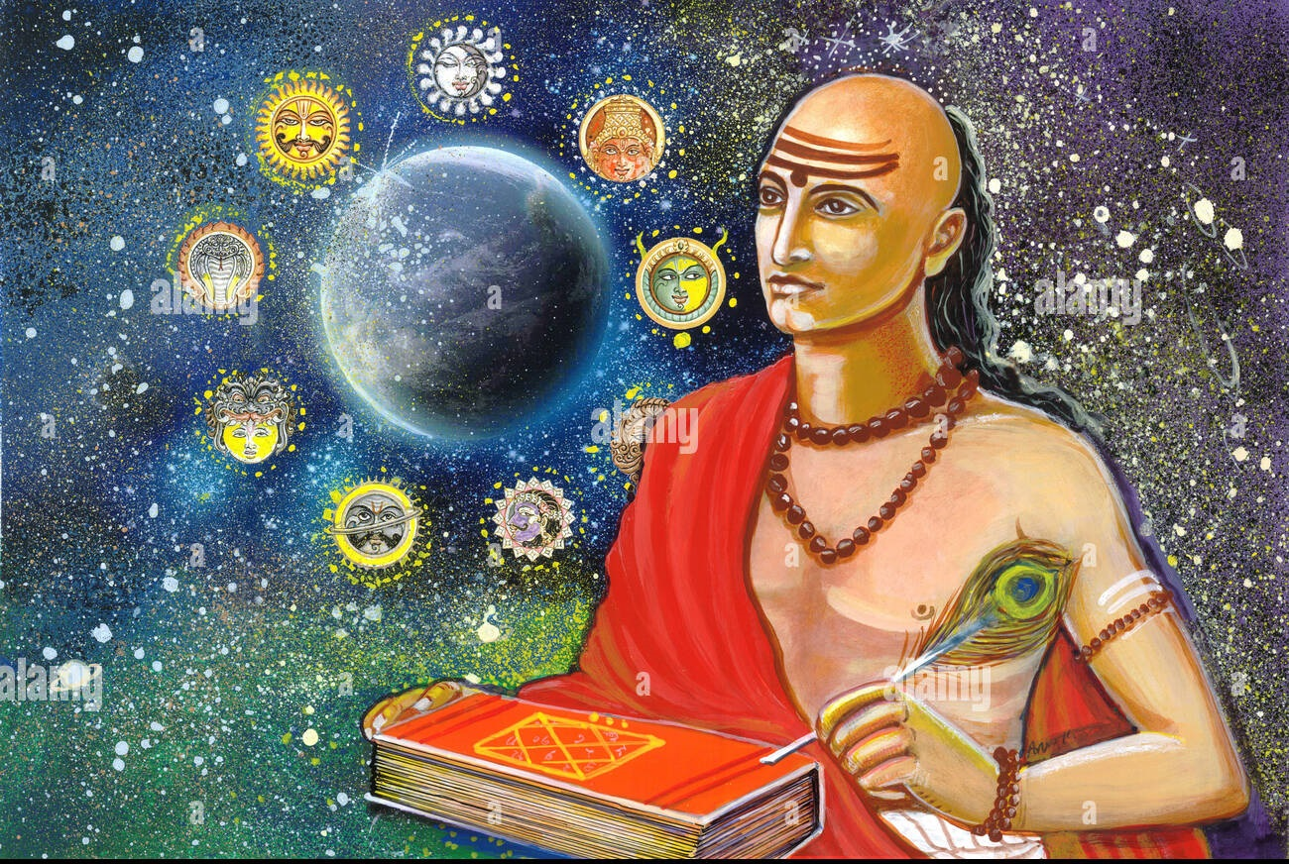
Introduction to Indian Knowledge System
Astronomy of first millennia.

Slide 10
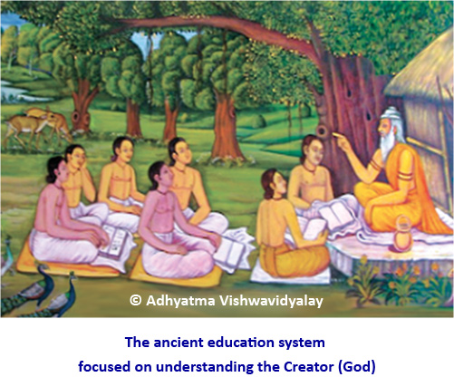
Introduction to Indian Knowledge System
Indian ancient knowledge system was preserved and transmitted ‘Orally’ few centuries back.
Our ‘Guru – Shishya’ lineage was very famous for flawless knowledge.

Slide 11
Introduction to Indian Knowledge System
Disruption in Traditional Education (200 Years Ago):
Major changes in the educational system in India led to an abrupt end of the traditional method of knowledge transmission and continuity, known as the Guru-Sishya Pratha.
Shift to Modern System (Last 50 Years):
Over the past 50 years, the population largely abandoned traditional practices in favor of a new educational system focused on economic prosperity, job security, and salaries.
Adoption of British Educational System:
Post-independence, India continued with the British system of education, neglecting its ancient knowledge systems and disregarding their rigor (કઠોરતા) and scientific values.

Slide 12
Base of Indian Knowledge System

Slide 13
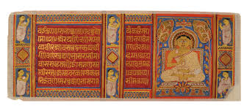
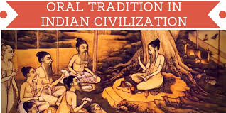
Importance of Indian Knowledge System
Indian ancient knowledge is accrued knowledge over several generations and preserved in formal (documented) and informal (shared values and practices through oral tradition) means.
Sadly saying Indian Ancient Knowledge System has been relegated to millions of palm manuscripts lying scattered all over the country and it is gathering dust.

Slide 14
Importance of Indian Knowledge System
Several scholars are engaged in process of bringing the hidden knowledge out of this manuscripts by researching and republishing such work to make it impactful in society.
On the other hand, the Oral tradition of passing knowledge continues in some rural pockets and are in threat of getting extinct.
Now the Question comes in front of us is,
“Does any society need to preserve, protect and pass on ancient knowledge to the future generations?”
YES
Why?

Slide 15
Importance of Indian Knowledge System
Ancient Knowledge
Identity
Culture
Received Wisdom
Economic Value

Slide 16
Importance of Indian Knowledge System
Identity:
The value that our ancient knowledge brings to society is the identity it provides to fellow members of the society.
It defines context for several aspects of day-to-day living.
Social practices and norms have continuity as they are transmitted from generations to generations through practices and support knowledge repositories too.
It is too important to preserve this knowledge and pass it to next generations for setting up of current society.
If it is not done so, individuals in society lose their ability to making meaning from living practices.

Slide 17
Importance of Indian Knowledge System
Culture:
Culture has several dimensions. Directly it is manifestation (અભિવ્યક્તિ) of human intellectual achievement regarded collectively by society over a period of time.
Social perspective, culture is nothing but set of ideas, customs and behaviour.
It can also be said as sense of identity at a societal level by providing common medium for communication and transaction of ideas.
Indian Knowledge system play a significant role in shaping culture of society.

Slide 18
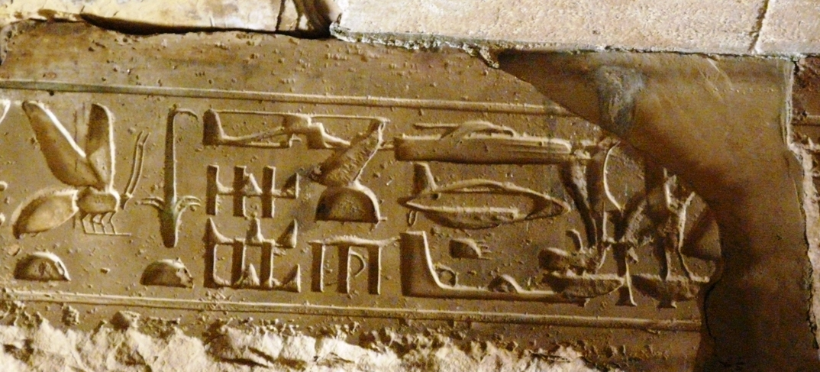
Importance of Indian Knowledge System
Received Wisdom (જ્ઞાન):
Knowledge and innovation are in a continuum.
Innovation and new knowledge creation in society is ‘Path – dependent’.
Without continuity of thought, it is just like reinventing Wheel.
Benefit of prior knowledge and thought process is lost makes society inefficient.
Ancient knowledge system in this context plays a valuable role in received wisdom.
Plane in Ancient Carving
& invented in 1903.

Slide 19
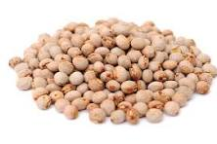
Importance of Indian Knowledge System
Economic Value:
Very important argument for current generation in support of ancient knowledge system is this as it has huge potentials for economic value standpoint.
Emerging world puts greater emphasis on knowledge society.
Military power also give a way to knowledge power.
Those nations are strong and superior in knowledge who bound themselves and demonstrate traditional knowledge or ancient knowledge.
They transform ancient knowledge into economical value by patenting knowledge as intellectual property.
Ex. Pigeon pea (US patent and trademark office granted patent for medical use in treating in diabetes, obesity, cardiovascular disease.
Our famous Gujarati – “Kabutar Vatana”

Slide 20
Need of Indian Knowledge System
Protecting Our Knowledge:
It's important to protect our traditional wisdom, not just know it, because it’s linked to our pride and economic safety.
Losing Rights through Patents:
Many countries are trying to patent (claim ownership of) our traditional knowledge, which means we could lose control over it.
A U.S. company got a patent for a pesticide made from the neem tree, which Indians have used for ages in farming and cooking.

Slide 21
Need of Indian Knowledge System
Global Issue with Traditional Remedies:
The issue of other countries patenting our traditional remedies is a big problem worldwide.
Need for Stronger Support:
To fight this, we need stronger organizations like CSIR (Council of Scientific and Industrial Research) to protect our knowledge legally.
In 1995, the U.S. patent office granted six patents for turmeric (used in India for centuries) to researchers at the University of Mississippi, which was controversial.

Slide 22
Need of Indian Knowledge System
As same as Neem, Turmeric – Amla, Jar Amla, Anar, Salai, Dudhi, Gulmehndi, Bagbherenda, karela, Rangoon- ki – bel, Erand, Vilayetishisham and Chamkura all are in list of Indian fights for patent.
Dr. Mashelkar (CSIR’s director) also highlighted importance of documenting traditional knowledge to provide evidence of prior knowledge
Hence, knowledge of IKS becomes critical in this journey.

Slide 23
History and Definition of Indian Knowledge System

Slide 24
History of Indian Knowledge System
Before 3000 BCE
3000 BCE to 500 BCE
500 BCE to 1800 BCE

Slide 25
History of Indian Knowledge System
Vedas
Rig-Veda
Yajurveda
Sama Veda
Atharva Veda
Before 3000 BCE
Puranas
Siksa
Vyakarana
Nirukta
Chandas
Jyotisa
Kalpa
Dharma Shashtras - Mahabharata & Ramayana

Slide 26
History of Indian Knowledge System
Vedanga-Jyotisa
Manu Smrti
Sulba Sutras
Astadhyayi Niruka
Natyashashtra
3000 BCE to 500 CE
Nyaya and Vaisesika Sutras
Arthshashtra
Yoga Sutras
Maha-bhasya
Charak Samhita
Amarakosa etc.

Slide 27
History of Indian Knowledge System
Aryabhatiya
Panca Sidhhantika
Mayamata
Brahmasphuta Sidhhanta
Manasara
500 CE to 1800 CE
Mahabhaskariya
Narada Silpa Shastra
Ganita-Sara Sangrah
Sidhhanta Sekhara
Yukti Kalpataru
Sidhhanta Siromani

Slide 28
Defining Indian Knowledge System
Indian Knowledge System is a generic phrase that practically covers everything of India.
All things show casing Indian history of more than 5000 years of record constitute Indian Knowledge System.
History
Abundant culture
Archaeological artifacts
Literatures
Social & community practices

Slide 29
Defining Indian Knowledge System
Indian Knowledge System has 3 Words.
Indian
Knowledge
System

Slide 30
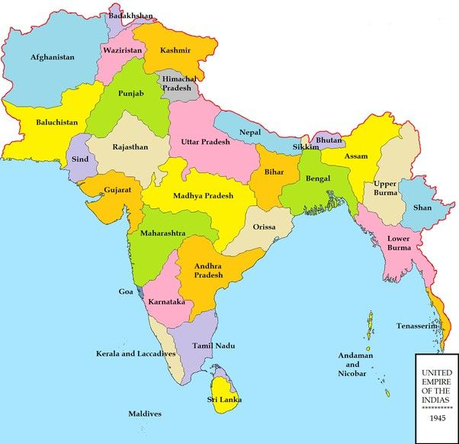
Defining Indian Knowledge System
Indian term refers to Ancient undivided subcontinent of Akhand Bharat
Till 16th Century Akhand Bharat included - Afghanistan, Bangladesh, Bhutan, India, Maldives, Myanmar, Nepal, Pakistan, Sri Lanka and Tibet as one nation.
Indian

Slide 31
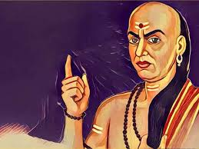
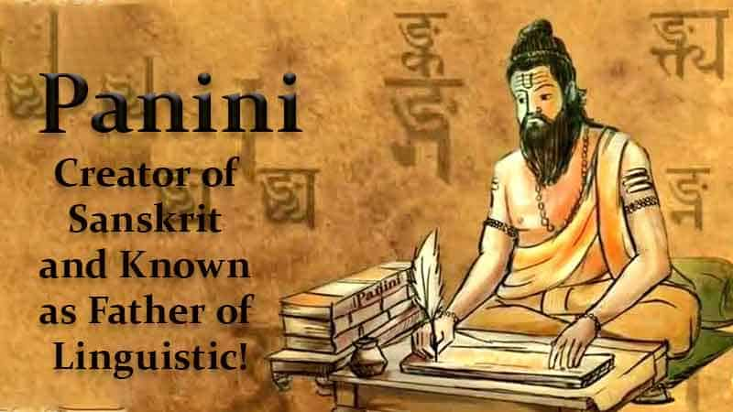
Defining Indian Knowledge System
Whole Akhand Bharat has common cultural, literary and social practices throughout the history of undivided India.
Some of the Expert thinkers famous from regions were –
Chanakya, in Taksashila in western part of Subcontinent .
Panini, a Sanskrit grammarian from Gandhara in north western corner (now Pakistan).

Slide 32
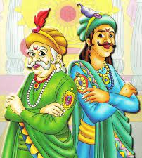
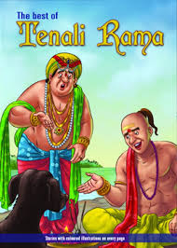

Defining Indian Knowledge System
Knowledge has tactical meaning of wisdom of knowledge seeker.
Tactical knowledge means rich traditional folklore in all three domains – Spiritual, religious and literary work.
Akbar and Birbal
Tenali Rama
Panchtantra
Knowledge

Slide 33

Defining Indian Knowledge System
By System we means, structured methodology and a classification scheme to access available corpus of knowledge.
Interconnection between codified and classified knowledge and definite framework with some logical relationship between them.
System

Slide 34
Framework of Indian Knowledge System & Sutras

Slide 35
Indian Knowledge System Corpus/ Framework
There are many ways to define and identify constituents or Framework of Indian Knowledge System.
One approach is to pick important topic representing knowledge i.e. Vedas, Yoga, Vastu, Silpa, Shastra, Ayurveda, Budhhism & Jainism etc.
Another approach is to select phrases such as Art, Science, Dance, Architect etc.
3 factors affect classification.
Completeness
Compactness
Inter connectedness

Slide 36
Indian Knowledge System Corpus/ Framework
Indian Knowledge System
Literary
Non – Literary
Sanatan Dharma
Other Dharmic Tradition
Regional
Oral Traditions
Art Form, Health, Food and life practice, Folklore
Core
Other
14 vidyasthana, Works of several religious leaders and philosophers
Basic and Applied Sciences, Engineering, Technology, Architecture etc.
Buddhist
Jain
Wealth of Religious and other literature in all major Indian Languages

Slide 37
Indian Knowledge System Corpus/ Framework
Sanatan Dharma – Core Literature comprises of vast repository starting with Vedas known as Sruti.
Although this Vedic corpus was oral in nature later systematic written document was formed.
It facilitated better understanding and implementation of ideas added to Vedic corpus.
This literature owed its allegiance to Vedas & extracted cardinal assumptions and principles from Vedas. Ex. 6 Schools of philosophical thoughts known as Darsanas.

Slide 38

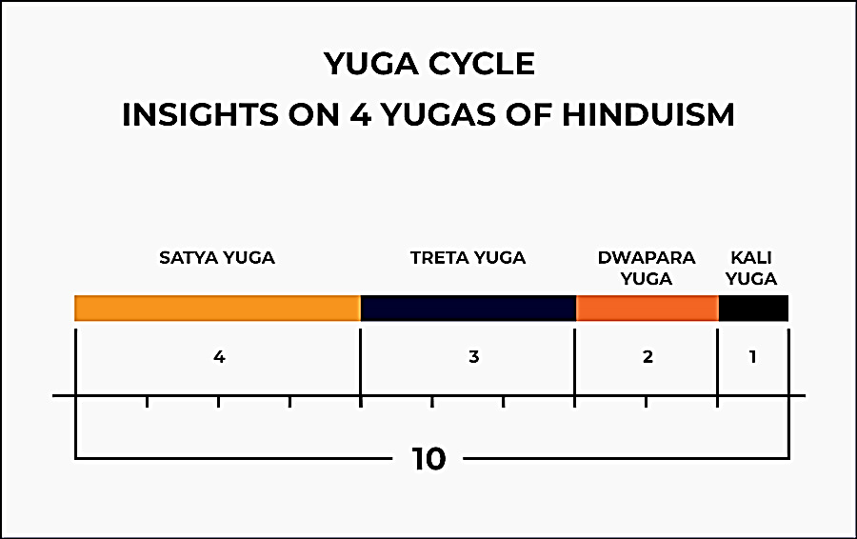
Indian Knowledge System Corpus/ Framework
Sanatan Dharma – Other Literature comprises of vast repository addressing to day to day life such as Health, Wellness, Science, Engineering, Technology etc.
They primarily addresses the variety of daily issues but they still own the allegiance of Sanatan-Dharma & acknowledge core assumption laid out in Vedas.
Ex. Astronomy of Aryabhatta recognizes the ideas of what constitute a year and the notion of four Yugas from the Vedic corpus proceeding with mathematical aspects.

Slide 39
Indian Knowledge System Corpus/ Framework
Basic and Applied Science
Mathematics
Astronomy
Engineering & Technology
Metal Working
Ship Building
Health, Wellness & Psychology
Charaka Samhitas
Susruta Samhitas
Plant Science
Dams & Water Shed Management
Alchemy
Cosmetics
Perfumes
Dyes
Town planning
Architecture
Astanga hradaya
Psychology
Alchemy
Ayurveda
Rasaratna Samuccaya
Yoga
Samakhya
Upnisads
Niti Sastras
Poetic Verses & stories on Samanaya niti
Niti Sastras as Raj niti
Public Administration
Manu Smrti
Arthshashtra
Niti shastra of Kamandaka
Asthetic, Kavyas & Performing Arts
Linguistic and phonetics of Sanskrit language by Kalidas, Dandin, Banabhatta
Kamasutra of Vatsyayana
Natya Sastra of Bharata

Slide 40
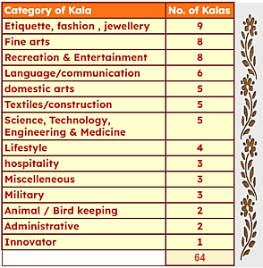
Indian Knowledge System Corpus/ Framework
Oral Traditions – 64 Kalas (main classification)

Slide 41
Indian Knowledge System Corpus/ Framework
14
Caturdasa Vidyasthana or
18 Vidyasthana
4 Vedas – Rigvedas, Yajur Vedas, Sama Vedas, Atharva Vedas
6 Vedangas – Siksa, Vyakarana, Nirukta, Chandanas, Jyotisa, Kalpa
6 Darsanas – Nyaya, Vaisesika, Yoga, Samkhya, Purva-Mimamsa, Uttra-Mimamsa
(18 Maha) Puranas, Smrti Sastras, Itihasas, Dharma Sastras
Sanatan-Dharma literature is organised in Caturdasa Vidyasthana (Caturdasa means 14) or 18 Vidyasthana

Slide 42
Indian Knowledge System Corpus/ Framework
The Vedas (Sruti) are the primordial (આદિકાળનું) source of knowledge in the scheme of the Sanatana-dharma literature.
The Puranas contains a rich repository of ideas that seek to explain various aspects of the Vedic thoughts, several socio-cultural ideas and practices for living.
Vedangas are six auxiliary disciplines associated with the study and understanding of the Vedas.
Darsanas essentially means a philosophical thought or view. There are six school of philosophy (Nyaya, Vaisesika, Yoga, Samkhya, Purva-Mimamsa, Uttra-Mimamsa) in the Sanatana-dharma literature and other schools.

Slide 43
Indian Knowledge System Corpus/ Framework
Puranas contains a rich repository of ideas that seek to explain various aspects of the Vedic thoughts using detailed stories and anecdotes. They present several socio-culture ideas and practices for living.
Itihasas relates to historical events that have taken place which can be associated with specific timelines. It represents the wisdom that we have accrued through the ages.
Dharma-sastra are norms and rules that act as a guide to lead a dharmic life based on principles of Vedas.
Smritis are rule books with specific operating guidelines of how to put dharmic principles ‘in action’, through case studies and real-life situations.

Slide 44
Encryption (Ancient Methods of Encryption)

Slide 45
Unique Aspects of Indian Knowledge System
Nuances (સૂક્ષ્મતા) of Oral Tradition
The pattern of IKS literature shows that a single work can provide simultaneously ideas on three streams seamlessly-
Spiritual
Religious
Secular
Therefore, the charm and power of IKS lie in its multi-dimensional perspective.

Slide 46
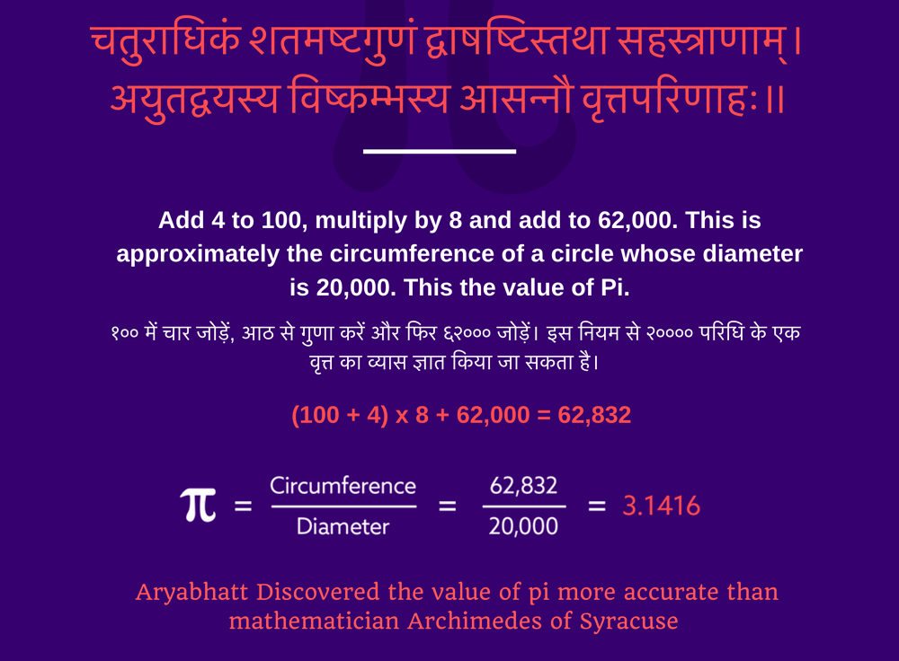
Unique Aspects of Indian Knowledge System
Typical Presentation Style-Sutras, Encryption
A large number of works in IKS are in verses set to a metrical structure irrespective of whether the subject matter is literature, mathematics or engineering.

Slide 47
Unique Aspects of Indian Knowledge System
Typical Presentation Style-Sutras, Encryption
Typically, mnemonics (sūtras) are employed to convey the message. A mnemonic is a memory mechanism and a learning technique that facilitates information retention or retrieval in human memory.
For example, Pingala in his work on Chandah-śāstra (છંદ શાસ્ત્ર​) dating back to the 2nd century BCE defined eight groups of binary numbers each of word length 3 (equivalent to what is now known in computer science as De Bruijn sequence). This can be represented using a simple mnemonic,
यमाता-राजभान-सलगम् (yamātā-rājabhāna-salagam)

Slide 48
Unique Aspects of Indian Knowledge System
Typical Presentation Style-Sutras, Encryption
Several innovative methods are used to make the message concise and amenable(અનુકૂળ) to a metrical presentation. A good example is to use encryptions to represent an idea.
One such example is Katapayādi system (an ancient Indian alpha syllabic numeral system to depict letters to numerals for easy remembrance of numbers as words or verses) and the Bhūta-samkhyā (a method of recording numbers using ordinary words having connotations of numerical values) system to represent numbers in unique ways so that these could be easily remembered and incorporated in a verse while discussing mathematical operations, numbers, and results.
Example: The number "four" can be associated with the word "Veda (वेद)" as there are four Vedas. In a similar manner, various numbers are associated with suitable words.

Slide 49
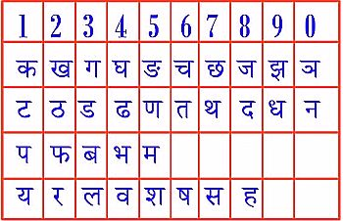
Unique Aspects of Indian Knowledge System
Katapayādi
Number | Words
0 | बिन्दु, नभस्, रन्ध्र, ख, आकाश, अभ्र, वियत्, पूर्ण, व्योमन्, अम्बर, जलधर, शून्य, ब्रह्मन्
1 | आदि, मुख, कु, वाच्, भूमि, रूप, भू, चन्द्र, वदन, ब्रह्मन्, इन्दु, कलि
2 | नेत्र, अयन, हस्त, युग्म, यम, युगल, अश्विन, चक्षुस्, पक्ष, अक्षि, पाणि
3 | शूल, गुण, शरीर, ग्राम, अग्नि, शक्ति, लोक, वह्नि, पुर, राम, काल
4 | उपाय, आम्नाय, समुद्र, आश्रम, कृत, जलधि, अब्धि, वेद, वर्ण, युग
5 | अर्थ, भूत, प्राण, पाण्डव, बाण, तन्मात्र, इन्द्रिय, वायु, काम
6 | तर्क, ऋतु, रस, रिपु, दर्शन, गुहवक्त्र, चक्रार्ध, अरि, अङ्ग, कृत्तिका, काल
7 | अचल, वासर, द्वीप, पर्वत, स्वर, अश्व, मुनि, तुरग, अद्रि, शैल
8 | गज, सर्प, नाग, दिग्गज, वसु, सिद्धि
9 | द्वार, गो, रन्ध्र, रस, निधि, अङ्क, नन्द, छिद्र, दुर्गा, ग्रह
10 | अवतार, अङ्गुलि, पङ्क्ति, दिश्, आशा, दिक्पाल
Bhūta-samkhyā

Slide 50
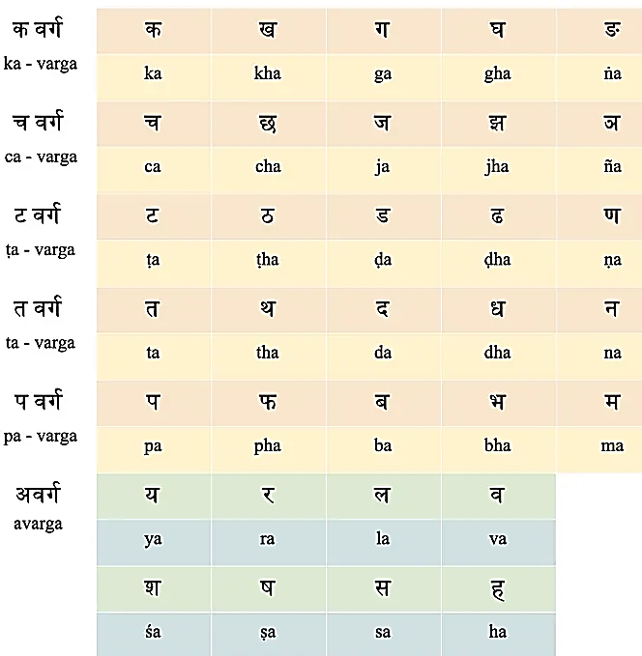
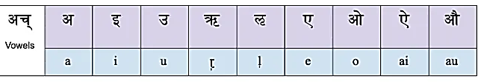
Unique Aspects of Indian Knowledge System
Typical Presentation Style-Sutras, Encryption
Another shining example is the Aryabhatțan system for number representation, with which he could represent the entire sine table (of differences) values in a verse (a couplet).
Notes:
https://adyakiran.medium.com/aryabhattas-system-of-numeration-f6f7b08e9d8d

Slide 51
Thank You
Indian Knowledge System
#2301DU005
India is the cradle of the human race, the birthplace of human speech, the mother of history, the grandmother of legend, and the great-grandmother of tradition.

